Slide 1
Copyright © 2006 MES-English.com

Slide 2
head

Slide 3
hair

Slide 4
face

Slide 5
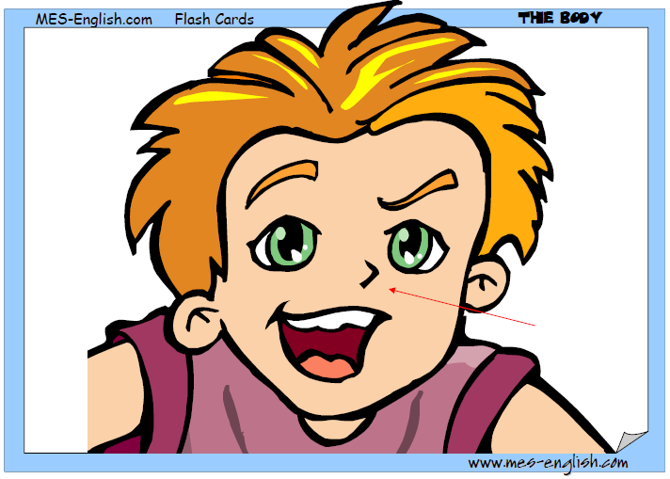
nose

Slide 6
ear

Slide 7
eye

Slide 8
mouth

Slide 9
teeth

Slide 10
neck

Slide 11
hand

Slide 12
finger

Slide 13
arm

Slide 14
elbow

Slide 15
knee

Slide 16
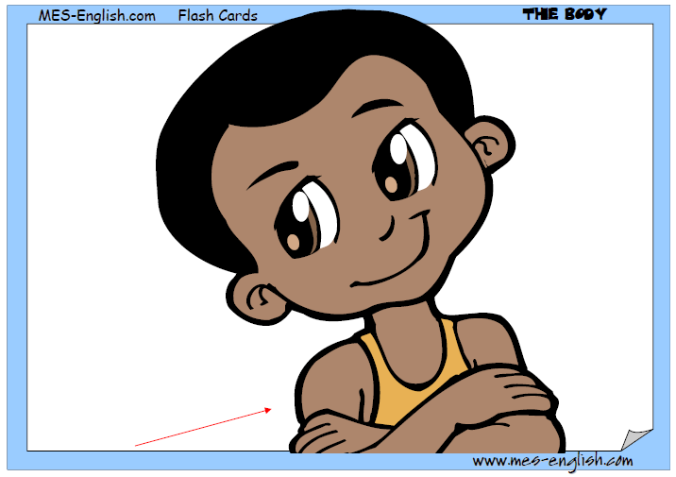
shoulder

Slide 17
back

Slide 18
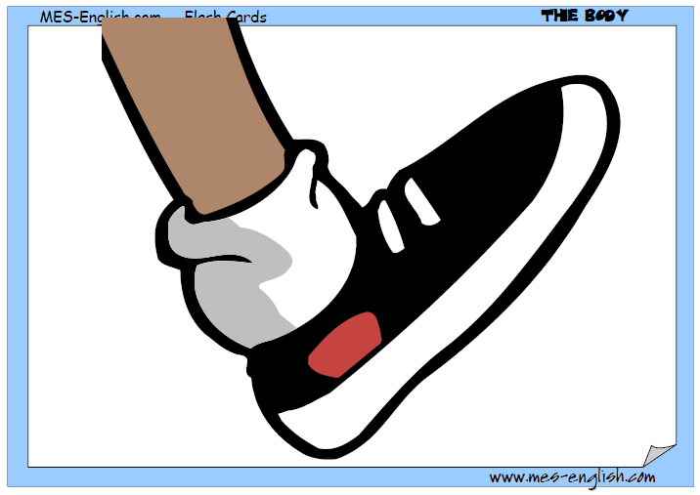
foot

Slide 19
toe

Slide 20
leg

